Slide 1

Lecture 17: Review Peer Comments on Your Prototype
Dr. Tsung-Wei Huang
Department of Electrical and Computer Engineering
University of Utah, Salt Lake City, UT
Notes:
Hello everyone, today we are going to help you go through the team forming process.

Slide 2

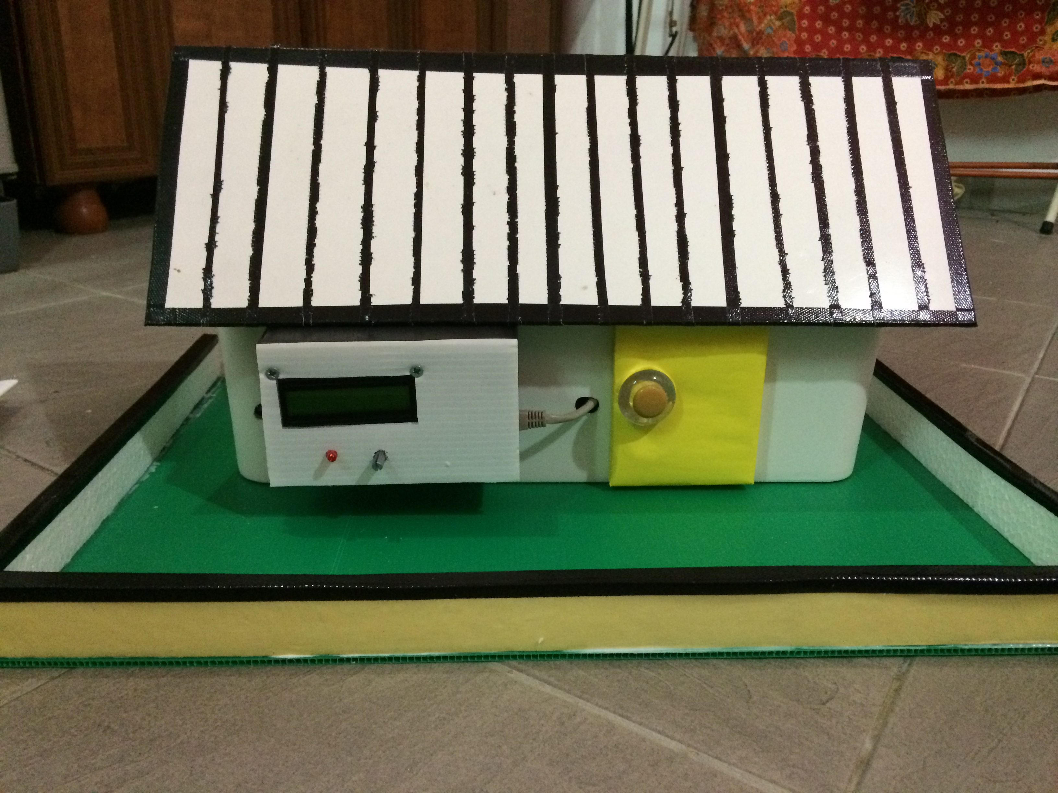
Prototype Recap
What is a prototype?
Final Goal: A house
Prototype: a small type of work to demonstrate the feasibility of your proposed approach to the final goal.
Key question: why should I believe in your proposed technical work?

Slide 3
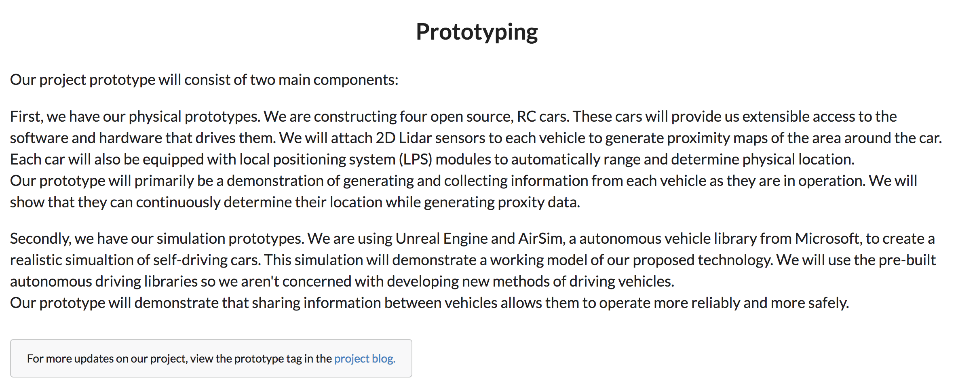
Example 1: MercuryMesh
https://mercurymesh.dev/

Slide 4
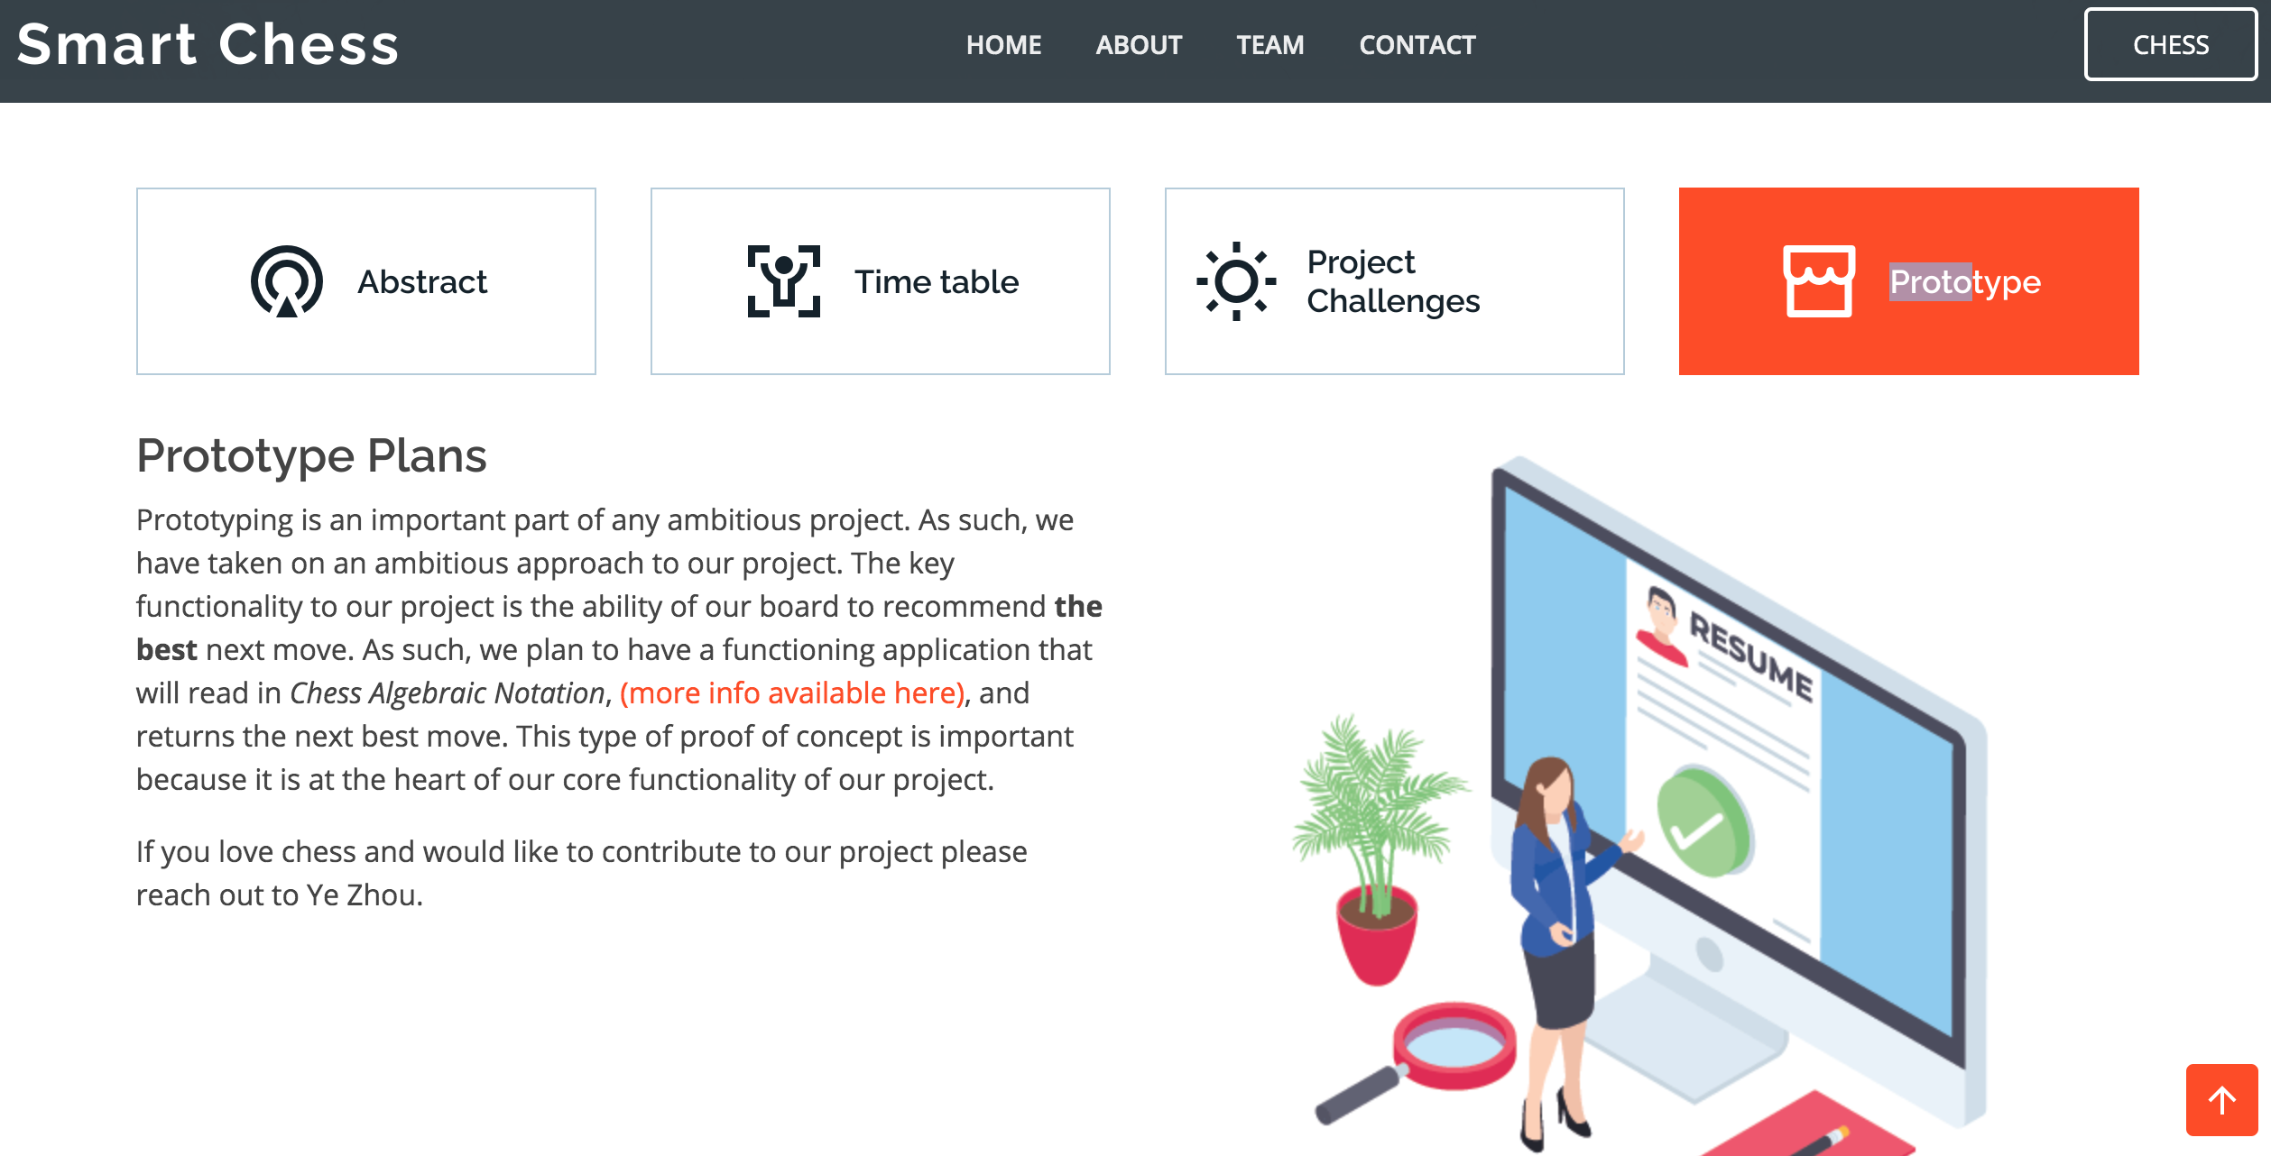
Example 2: Smart Chess
https://jason-zavala.github.io/smartchess/

Slide 5
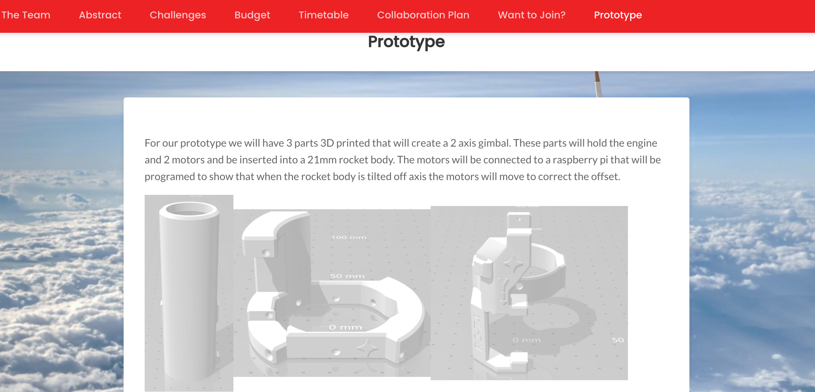
Example 3: UVector
https://vectoru.space/prototype/

Slide 6
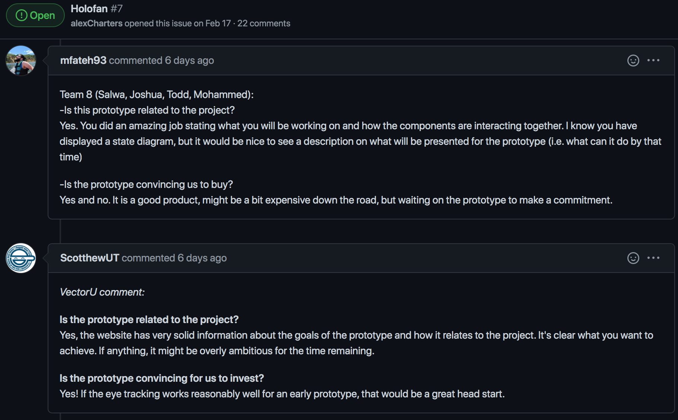
Peer Evaluation for Prototype
Each team should receive other’s comment
https://github.com/tsung-wei-huang/cs3992/issues

Slide 7
Why Peer Evaluation is Important?
Prototype is built to demonstrate to others
You need to demonstrate a prototype when you
Launch a new project in a company
Launch a start-up
Launch a research project
…
You need to let others know you can do it
OK, now I trust your technical capability
OK, now I know your idea is realistic

Slide 8
Project Prototype Discussion
We have opened 10 breakout rooms
Zoom: https://utah.zoom.us/j/2468214418
1-9 are assigned for each team
Thesis track students are in room 10
Each group works together to do the following:
Review others’ comments on your prototype at your project issue post: https://github.com/tsung-wei-huang/cs3992/issues
Discuss two items:
Do people correctly understand what you plan to do?
What do you plan to improve based on these comments?
We will come back to have each team to speak

Slide 9
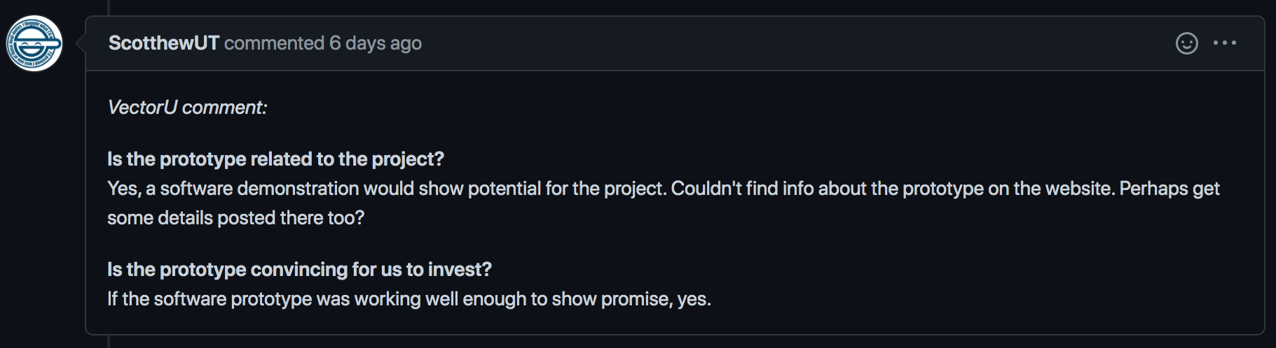
To Get You Off the Ground
Step #1: Visit the your project post
https://github.com/tsung-wei-huang/cs3992/issues
Step #2: Review comments on your prototype
Step #3: Discuss the two items in the worksheet
https://docs.google.com/spreadsheets/d/1JfWZkEyoXdVLtHkiwOqk24G7WVhLWMCP113cSe9fgsQ/edit#gid=771236172
Check in your attendance by marking your name in bold
Step #4: Select one person to present

